Slide 1



CHINOOK MUSIC STORE ANALYSIS
BY : AZHAR SHAIKH

Slide 2

AGENDA
ABOUT CHINOOK
OBJECTIVE
DATABASE SCHEMA
RECOMMEDATIONS
CONCLUSION

Slide 3
ABOUT CHINOOK
Chinook Music Store is a renowned platform that offers a diverse collection of music records in physical formats, catering to a global audience of music enthusiasts. With a rich catalog spanning various genres and artists, Chinook has established itself as a trusted destination for quality music. As the music industry evolves, understanding customer preferences and market dynamics has become increasingly vital for maintaining a competitive edge and driving business growth.

Slide 4

OBJECTIVE
The primary objective of this analysis is to examine Chinook's sales data to uncover actionable insights that can inform strategic decisions. By analyzing customer demographics, purchasing patterns, and sales performance across genres and geographies, the aim is to identify key trends and opportunities. These insights will be used to recommend strategies that enhance customer engagement, optimize inventory management, and boost revenue in the physical music market.

Slide 5
DATA OVERVIEW
customer:
customer_id: Unique identifier assigned to each customer.
first_name: The given name or first name of a customer.
last_name: The surname or family name of a customer.
company: The name of the company associated with a customer.
address: The street address of a customer's location.
city: The city where a customer is located.
state: The state or province where a customer is located.
country: The country where a customer is located.
postal_code: The postal or zip code of a customer's address.
phone: The phone number of a customer.
fax: The fax number associated with a customer.
email: The email address of a customer.
support_rep_id: The employee ID of the support representative assigned to a customer.
invoice:
invoice_id: Unique identifier assigned to each invoice.
customer_id: The customer ID associated with the invoice.
invoice_date: The date when the invoice was generated or issued.
billing_address: The street address used for billing purposes.
billing_city: The city used for billing purposes.
billing_state: The state or province used for billing purposes.
billing_country: The country used for billing purposes.
billing_postal_code: The postal or zip code used for billing purposes.
total: The total amount due on the invoice.

Slide 6
invoice:
invoice_id: Unique identifier assigned to each invoice.
customer_id: The customer ID associated with the invoice.
invoice_date: The date when the invoice was generated or issued.
billing_address: The street address used for billing purposes.
billing_city: The city used for billing purposes.
billing_state: The state or province used for billing purposes.
billing_country: The country used for billing purposes.
billing_postal_code: The postal or zip code used for billing purposes.
total: The total amount due on the invoice.
invoice_line:
invoice_line_id: Unique identifier assigned to each line item on an invoice.
invoice_id: The invoice ID to which the line item belongs.
track_id: The ID of the track or product included in the line item.
unit_price: The price per unit for the line item.
quantity: The quantity of units for the line item.
playlist:
playlist_id: Unique identifier assigned to each playlist.
name: The name or title of the playlist.
playlist_track:
playlist_id: The ID of the playlist to which the track belongs.
track_id: The ID of the track included in the playlist.
track:
track_id: Unique identifier assigned to each track or song.
name: The title or name of the track.
album_id: The ID of the album to which the track belongs.
media_type_id: The ID of the media type associated with the track.
genre_id: The ID of the genre associated with the track.
composer: The name of the composer or artist who composed the track.
milliseconds: The duration of the track in milliseconds.
bytes: The file size of the track in bytes.
unit_price: The price per unit for the track.

Slide 7
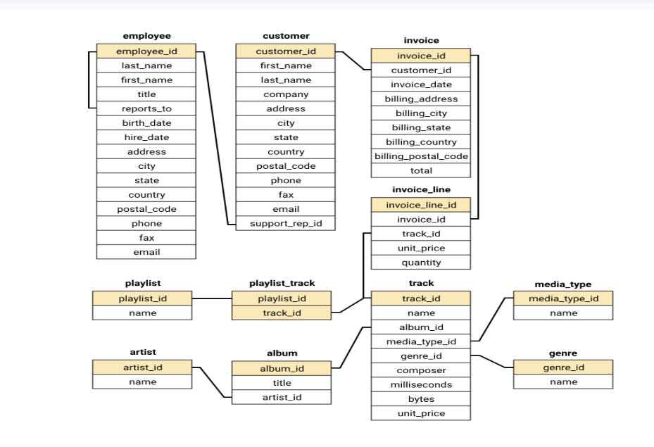
DATABASE SCHEMA

Slide 8
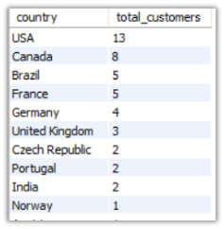
Customer’s Demographic Breakdown
Insights :
USA , CANADA , Brazil , France shows largest customer base
Norway , Italy , Spain are among the least customer base

Slide 9
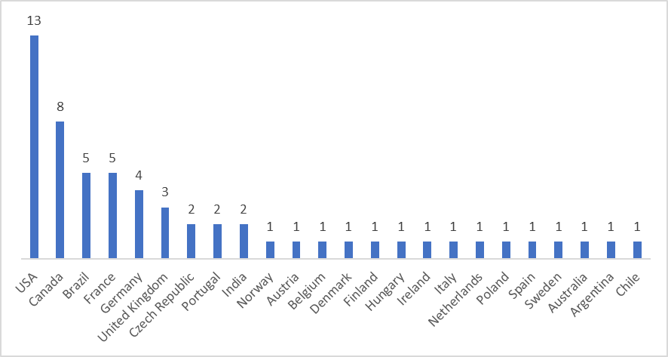
Customer’s Demographic Breakdown Chart

Slide 10
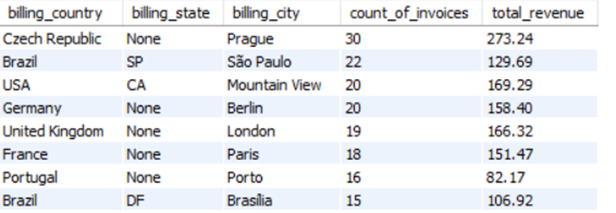
Total Revenue by Country
Insights :
Czech Republic ,Brazil,USA
these are the top 3 countries
according to the revenue

Slide 11
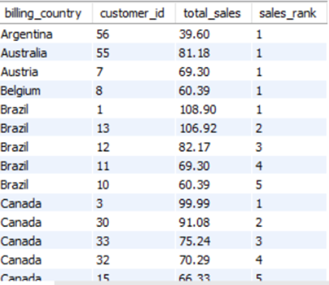
Top 5 Customers by Total Revenue in each Country
Insights :
The highest revenue-generating customer is František Wichterlová from the Czech Republic, with a total revenue of 144.54.
Customers are spread across various countries, with notable contributions from Brazil, the USA, Canada, and the Czech Republic.

Slide 12
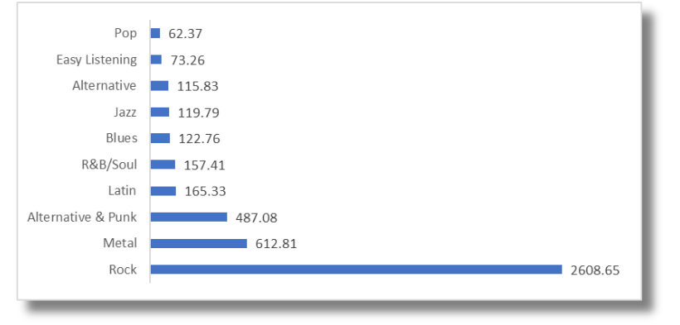
Genre Sales Analysis
Insights :
While Rock leads by a wide margin, there is notable diversity in preferences for other genres such as Metal, Alternative & Punk, and Latin, which show moderate levels of interest. Genres like Pop (62.37) and Easy Listening (73.26), however, have relatively low engagement, suggesting limited appeal.

Slide 13
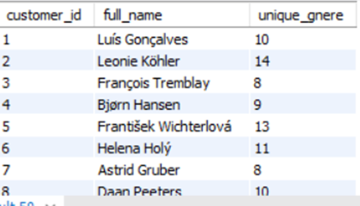
Customers who have purchased track from 3 diffrent genre
Insights :
Leonie Köhler is the customer with the highest genre diversity, having purchased tracks across 14 different genres.
Several customers, including František Wichterlová, Terhi Hämäläinen, Madalena Sampaio, and others, have purchased from 13 different genres, indicating a broad music taste.

Slide 14
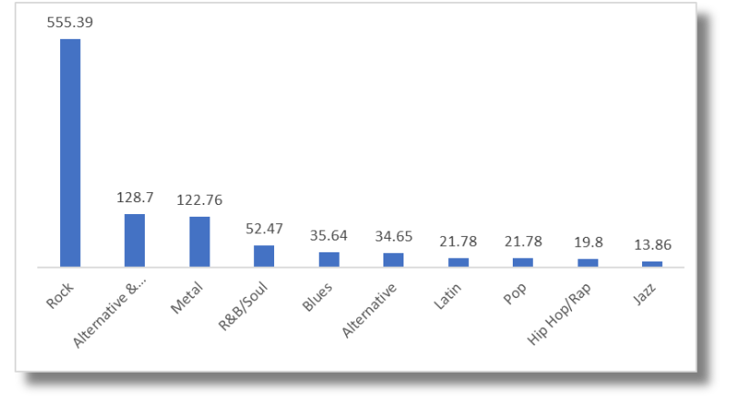
Genres based on their sales performance in the USA
Insights :
Dominance of the Rock Genre: The Rock genre has significantly higher sales (555.39) compared to other genres. It is the most popular by a wide margin, indicating a strong customer preference for Rock music.
Steep Drop After Top Three: The next two genres, Alternative & Punk (128.7) and Metal (122.76), show significantly lower sales than Rock but are still well ahead of the remaining genres.

Slide 15
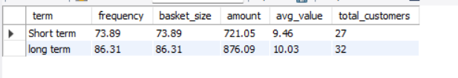
Long term and Short term Users
Insights :
Long-term customers have higher metrics across all categories compared to short-term customers:
Frequency: 86.31 vs. 73.89
Basket Size: 86.31 vs. 73.89
Total Amount Spent: 876.09 vs. 721.05
This suggests that long-term customers are more consistent and valuable in terms of overall contribution to sales.

Slide 16
Conclusion
Data Integrity and Accuracy: Steps to address null values and duplicate entries have ensured the accuracy and reliability of the Chinook database for meaningful analysis.
Genre Popularity: Rock emerges as the dominant genre, especially in the USA, contributing significantly to sales. Strategic investment in Rock music can drive customer engagement and revenue growth. Regions like Brazil show unique preferences for genres such as Alternative & Punk and Metal, indicating the need for regionalized marketing strategies.
Customer Insights: Long-term customers demonstrate higher spending and loyalty, offering opportunities for premium services and exclusive promotions. Meanwhile, new customers represent growth potential through personalized marketing efforts.

Slide 17
Recommendations
Prioritize high-performing genres like Rock for global promotions.
Develop region-specific strategies for markets with unique preferences, such as Brazil.
Implement loyalty programs for long-term customers to strengthen retention.
Utilize affinity insights to optimize product recommendations and cross-selling efforts.

